Slide 1
HANDWRITTEN DOCUMENT IMAGE FORGERY DETECTION

Slide 2
INTRODUCTION
The study aims to explore the application of deep learning techniques for handwritten document image forgery detection.
In this Project, we consider the document type to consist of three parts that is Logo, Text and Signature. Majority of the important documents have this three components.
The forgery we detect can be classified as hand-written signature forgery and copy-move forgery of any photo, text, or signature. We have developed a novel approach using capsule layers to detect a forgery in handwritten signatures. We also use ELA (Error Level Analysis) to detect any error in the compression levels of the image.

Slide 3
PROBLEM DEFINITION
The problem of handwritten document forgery poses a significant challenge in ensuring the authenticity and reliability of important documents.
The goal is to develop a robust and automated system that can effectively detect various forms of forgery, 3 such as signature forgery, alteration of handwritten text, or the creation of entirely fabricated handwritten documents.

Slide 4
PROPOSED SYSTEM
The following steps outline the methodology.
1. Data Collection
2. Data Pre-processing
3. Model Selection and Architecture
4. Training and Validation
5. Model Evaluation
This system considers 3 important parameters or parts for recognition and detection.
Logo , Handwritten Text or other text and Signature.

Slide 5
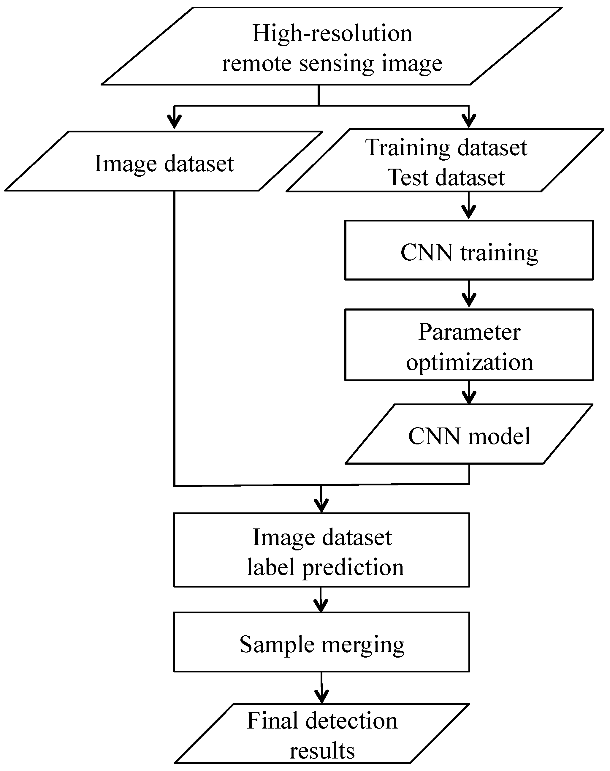
FLOW CHART

Slide 6
REQUIREMENTS
HARDWARE REQUIREMENTS.
Hard Disk: 1.2GB or above
RAM: 8 GB
Processor: Intel i5 Processer or above PREPROCESSING
SOFTWARE REQUIREMENTS.
Python 3.6.8
Deep learning frameworks such as TensorFlow, Kera’s, or Torch
Image processing libraries such as OpenCV
Jupiter Notebook or an Integrated Development Environment (IDE) such as PyCharm or Visual Studio Code

Slide 7
CODING
Python Programming:
Libraries and Framework used.
1. Keras
2. TensorFlow
3. Lumpy
4. Pillow
CNN – Convolutional Neural Network:
CNNs have achieved state-of-the-art performance on a wide range of image recognition tasks, including object classification, object detection, and image segmentation.
A convolutional neural network, or CNN, is a deep learning neural network sketched for processing structured arrays of data such as portrayals.
CNN contains many convolutional layers assembled on top of each other, each one competent of recognizing more sophisticated shapes.

Slide 8
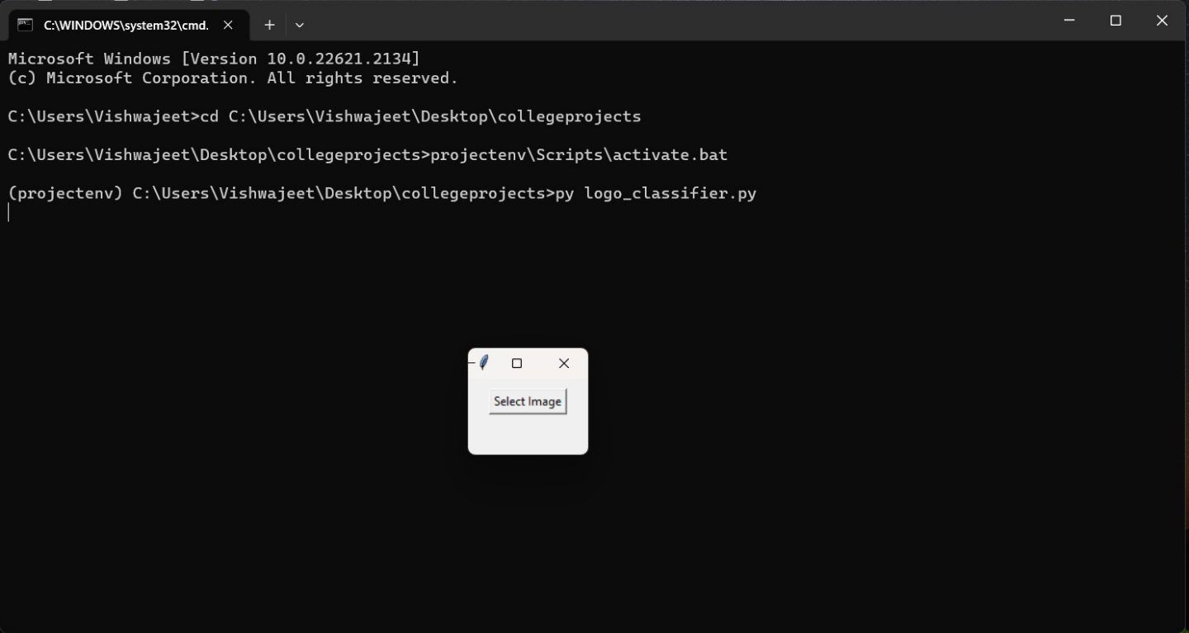
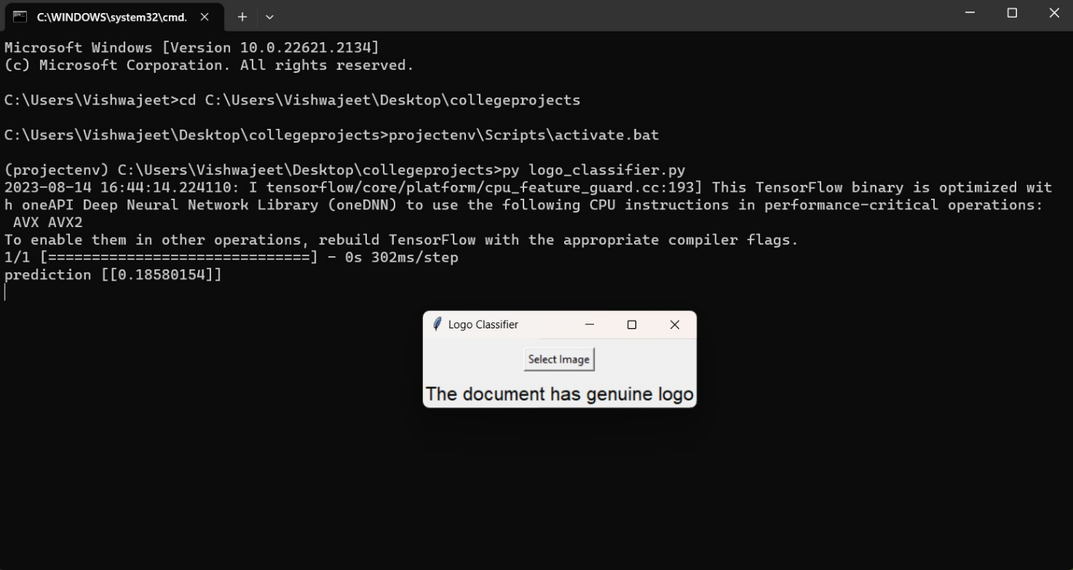
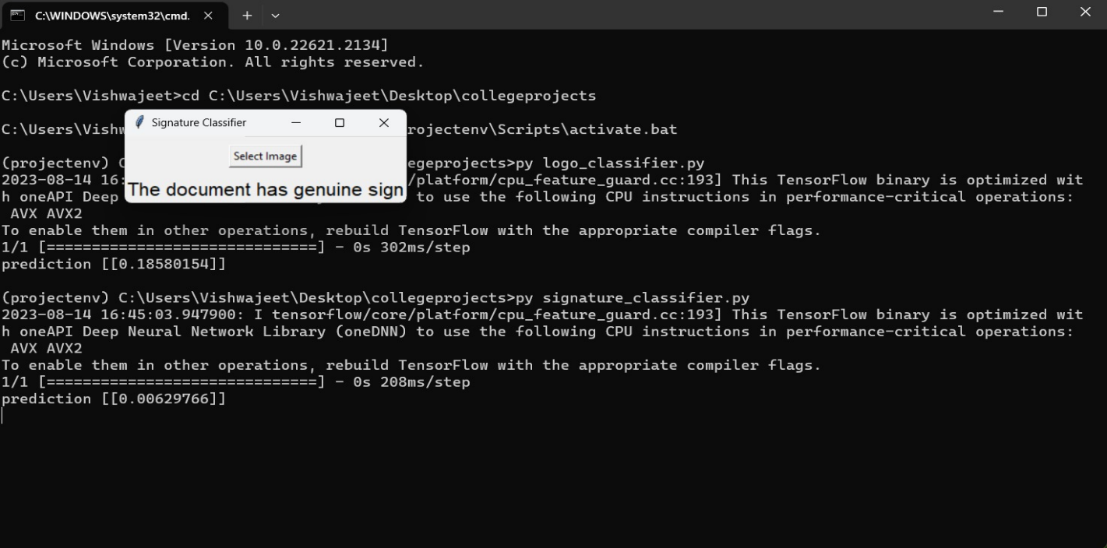
SCREENSHOTS

Slide 9
CONCLUSION
In this project as the document image is considered to be of 3 parts the logo, text and signature all three components are subjected to reading and the logo and signatures are tested for forgery detection
The model can detect forgeries regarding only the logos and signatures which have already been stored in its dataset.
Future Scope
The base has been set to improve the project to another level by using Custom Object Detection to identify the components of any kind of document like cheques, certificates and many other documents which is possible by providing a sufficient and thorough dataset.

Slide 10
REFERENCES AND BIBLIOGRAPHY
Websites referred
www.stackoverflow.com
www.pythonprogramming.net
www.codecademy.com
www.tutorialspoint.com
www.geeksforgeeks.com
www.wikipedia.org
www.youtube.com
www.kaggle.com
Guidance
Meritude Skills, Haegl Technology-guidance

Slide 11
THANK YOU

